Slide 1
Georgia: Physical Features and Location
SS8G1a
SS8G1b

Slide 2
SS8G1: The student will describe Georgia with regard to physical features and location.

Slide 3
a. Locate Georgia in relation to region, nation, continent, and hemisphere.

Slide 4
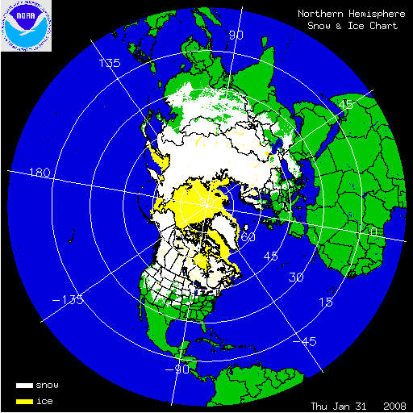
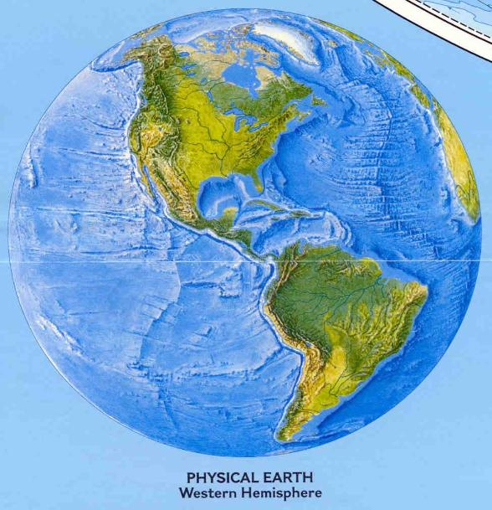
Where in the world is Georgia?
Georgia is located in the Northern (latitudinal) hemisphere.
Georgia is located in the Western (longitudinal) hemisphere.

Slide 5
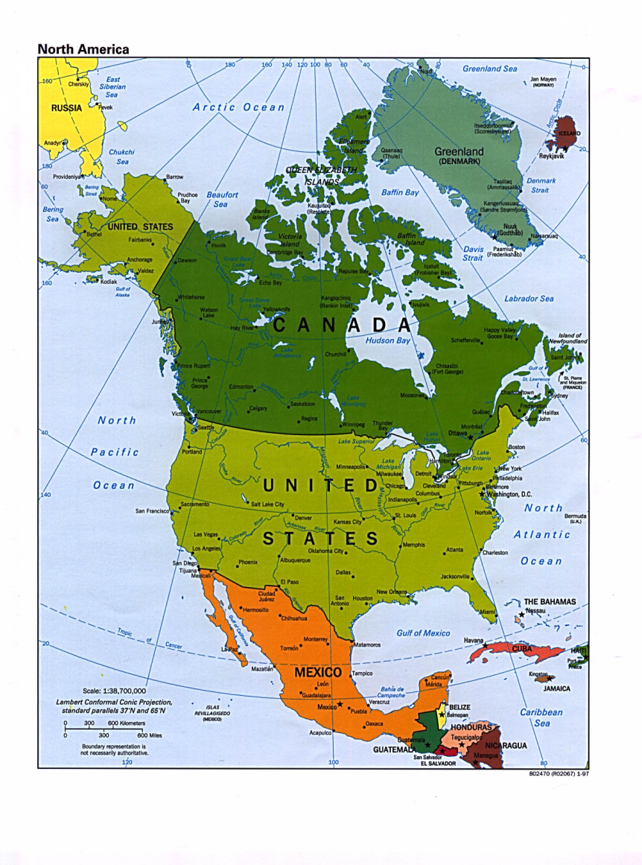
Where in the world is Georgia?
Georgia is located on the continent of North America

Slide 6
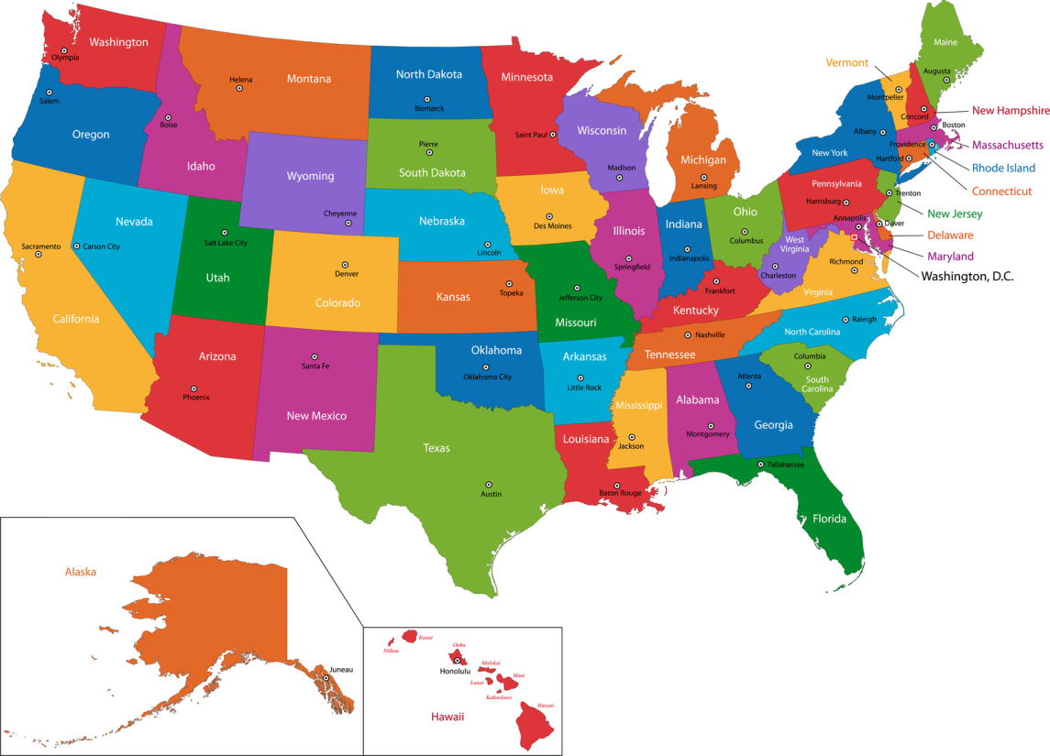
Where in the world is Georgia?
Georgia is located in the United States of America.

Slide 7
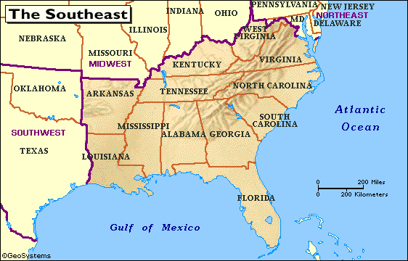
Where in the world is Georgia?
Georgia is located in the Southeastern United States.

Slide 8
SS8G1b. Describe the five geographic regions of Georgia

Slide 9
Five Geographical Regions
The state of Georgia is divided into 5 geographic regions. In the north, there are three small mountainous regions, each with a differing topography.
In the middle of the state is the hilly Piedmont area which is home to many of Georgia’s largest cities including Atlanta.
Finally, the state is dominated by the Coastal Plain region, which takes up three-fifths of Georgia. The Coastal Plain, which is divided into an inner and outer section, was actually covered by water millions of years ago.

Slide 10
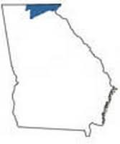
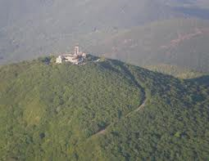
The Blue Ridge Region
The Blue Ridge region is located in the northeastern portion of the state.
The region is home to Georgia’s largest mountains, including Brasstown Bald which is the highest peak in the state.

Slide 11
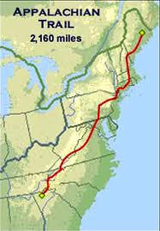
The Blue Ridge Region
The southern most point of the Appalachian trail is in the Blue Ridge region.
Dahlonega is an important city in the region. It was the site of America’s first Gold Rush.

Slide 12
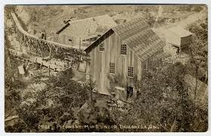
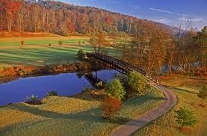
The Blue Ridge Region
In the past, the primary industry of the region was mining.
Today, due to the region’s scenic beauty, it is tourism.

Slide 13
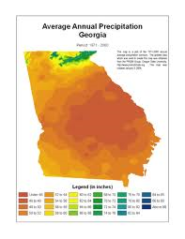
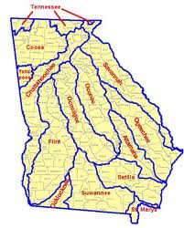
The Blue Ridge Region
The Blue Ridge receives the most precipitation in the state, over 80 inches a year.
The Blue Ridge is also the starting point of most of Georgia’s rivers.

Slide 14
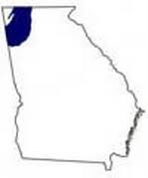
The Valley and Ridge Region
The Valley and Ridge region is characterized by low open valleys and narrow ridges.
The area was traditionally a mining region, with valleys being used for agriculture.

Slide 15
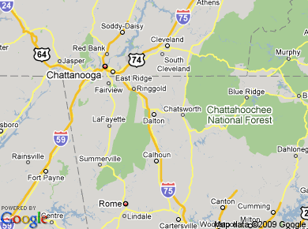
The Valley and Ridge Region
The region has several cities and towns, including Cartersville and Calhoun.
However, Dalton is probably the most important city due to its textile and carpet industry.

Slide 16
The Valley and Ridge Region
Historically, this region was a major battle ground during the Civil War.
It is also a major transportation route between Georgia and Tennessee.

Slide 17
The Appalachian Plateau
The Appalachian Plateau is located in the northwestern corner of the state and is Georgia’s smallest region.
It is sometimes called the “TAG” region, as the states of Alabama, Tennessee, and Georgia all connect at one point.

Slide 18
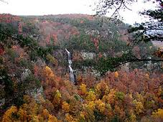
The Appalachian Plateau
This region includes all of Dade county and part of Walker county.
Cloudland Canyon State park is located in this region.

Slide 19
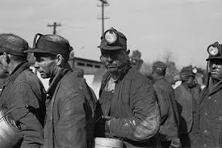
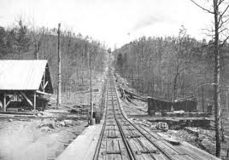
The Appalachian Plateau
Mining was an important economic activity in the region.
Coal was the most important product.
Due to poor soil, agriculture was limited in the Appalachian Plateau.

Slide 20
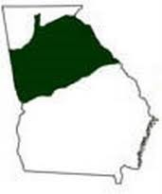
The Piedmont Region
The Piedmont Region is the middle of the state and the most populous.
With over 4,500,000 people, almost one-half of Georgia’s population lives in this region.

Slide 21
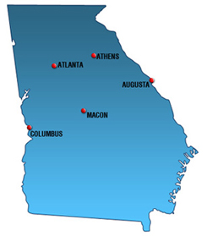
The Piedmont Region
Many of Georgia’s most important cities are located in the region including Athens, Atlanta, Augusta and Macon.

Slide 22
The Piedmont Region
Manufacturing is important in the region.
Agriculture, primarily in the form of poultry, is also a significant enterprise.

Slide 23
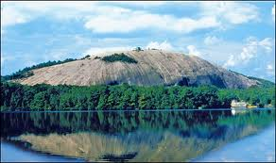
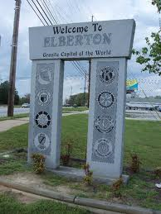
The Piedmont Region
Due to the large amount of granite found in the region, mining has been important. (Think Stone Mountain)
Elberton is known as the “Granite Capital of the World”.

Slide 24
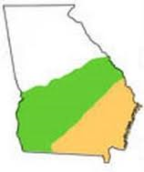
The Coastal Plains Region
The largest region in Georgia is the Coastal Plain.
Making up three-fifths of the state, this region is actually divided into two areas: the Inner and the Outer Coastal Plain.

Slide 25
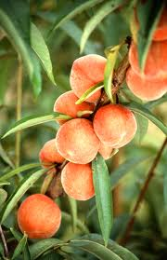
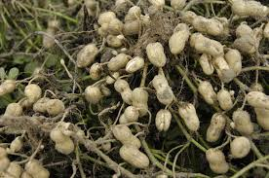
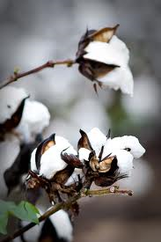
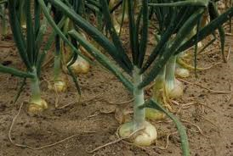
The Coastal Plains Region
The Inner Coastal Plain is the agricultural heartland of the state.
In this region peaches, peanuts, cotton and the famous Vidalia onions are important crops.

Slide 26
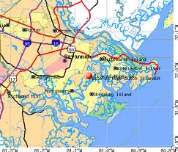
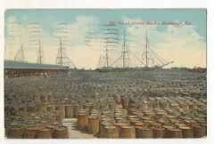
The Coastal Plains Region
The Outer Coastal Plain is the home of Georgia’s oldest city, Savannah, which was founded in 1733.
Due to the abundance of pine trees in the region, naval stores were an important industry in the state.

Slide 27
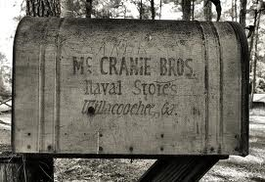
The Coastal Plains Region
Today the trees are used for pulp and paper production.
Baxley, Georgia is the only naval stores producer in the nation today.
Tourism, shipping, and seafood are all important industries in the region.

